Slide 1
Chairs’ Network Meeting 8th March 2021
Clare Tunnicliffe

Slide 2
Agenda
Grant Davis – Schools Strategic Financial Support Manager
Chairs Forum evolution
Working together with Wiltshire Council
What else do you want from WGA

Slide 3
Welcome to Grant

Slide 4
Wiltshire Governors Association Finance Update
March 2021

Slide 5
Programme for the day
Wiltshire introduction
Statistics
Schools Forum
Funding
Where the money comes from
Funding Factors
High Needs
Funding Update
Notional SEN
Budget Planning 2021-22
Income
Expenditure
Other Areas
Covid Update
Consultations
School Financial Value Standard / Schools Resource Management Self-Assessment tool

Slide 6
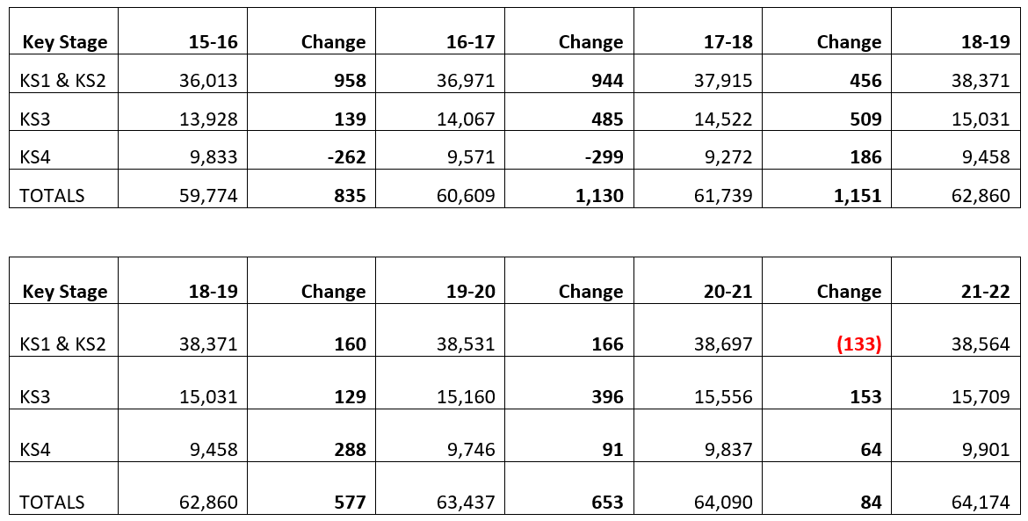
Wiltshire Schools – Funded Pupil Numbers

Slide 7
Wiltshire Schools – Birth Rate Data

Slide 8
Wiltshire Schools
Mainstream Schools
Primary 202 schools
Secondary 29 schools
Special Schools – 4 schools
No new schools opened in September 2020 or planned for 2021
Schools closed
- last maintained school that closed was Lypiatt Primary School – August 2019
- Salisbury UTC ceased and closed August 2020
Special School Re-organisation
- Rowdeford, St Nicholas, Larkrise now Silverwood School – September 2020

Slide 9
Wiltshire Schools - Update
Mainstream Schools
120 Maintained Primary schools
4 Maintained Secondary schools
82 Primary Academy Schools
25 Secondary Academy Schools
Special Schools
4 across the County (2 Maintained, 2 Academy)
Plans for a new ‘Free’ Special School in South of County
Resource Bases - Primary 18 schools
ELP - Secondary 27 schools

Slide 10
Schools Forum
Have you heard of Schools Forum?
Who
What
Why
When
Where
Schools Forum Papers

Slide 11
School Funding & Financial Framework
Main grants supporting school revenue budgets
Dedicated Schools Grant (DSG)
Use prescribed by regulation and allocated to LA in 4 blocks
- Schools block
- Central services block
- High needs block
- Early years block
Post 16 funding
National 16-19 funding formula to fund 6th form provision in schools
Pupil Premium
Targets funding at vulnerable pupils
SB
CB
HNB
EYB

Slide 12
Blocks – What are they?
Schools Block – funds mainstream schools
Central Block – for services to all schools (maintained or academy), e.g. Admissions, Strategic Property Planning, School Funding
High Needs Block – Special schools, Resource bases, ELPs, NPAs, SEN Support Teams
Early Years Block – Nurseries and early years settings, funding for 2 year olds and 3&4 year olds
Each Block has a separate formula and is accounted for separately
Approval required for transfers between Schools Block & High Needs Block (2020-21 and 2021-22 – 0.5%)

Slide 13
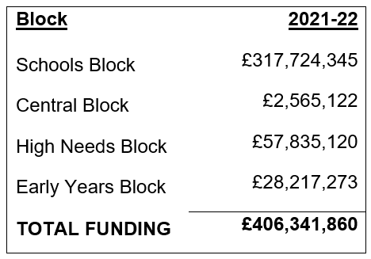
Blocks – What are they?

Slide 14
Blocks – Comparison over 3 years
Teachers Pay and Pension Grants now built into the Schools Block baseline, funded at £14,179,214 for 2021-22. Therefore, the ‘real’ increase is £10,402,364

Slide 15
2020-21 to 2022-23 - £14bn Pledge - Boost for schools
The Facts – Good News!
£14bn between 2020-21 and 2022-23, not annually
2020-21 - £2.6bn
2021-22 - £4.8bn
2022-23 - £7.1bn
National Schools Budget increased to £52.2bn

Slide 16
£14bn Pledge - Boost for schools
Latest Information 2021-22
Pupil-led and School-led funding factors increased by 3% includes:
Per pupil funding
Lump Sum
Prior Attainment
EAL
Deprivation
Excludes;
Other Premises Factors (Split sites, PFI, rents, sparsity, rates)

Slide 17
Budgets to schools 2021-22
Based upon the National Funding Formula
Schools Forum agreed principle of moving towards the NFF
Cabinet agreed the funding formula for 2021-22
Transfer of £1.517M from Schools Block to High Needs
Budgets with schools by the 28th February 2021 (deadline)
Maintained Schools – Budget Template – 18th June
Academies – Budget Forecast return - 27th July

Slide 18
National Funding Formula (NFF) – Key Factors
Basic Need and Additional Educational Needs factors
AWPU - ‘per pupil’ funding (funding rates KS1&2, KS3, KS4)
Minimum per pupil funding level (I’ll explain in more detail later!)
Deprivation – FSM, FSM Ever6, IDACI
Prior Attainment – EYFSP & KS2 progress
EAL – funded for first 3 years in state education
Mobility – a new factor for 2021-22
for pupils entering schools at a ‘non-standard’ entry point in the last 3 years. In effect pupils registered for the first time at schools on January and May census. Where greater than 6% of school population, extra funding

Slide 19
National Funding Formula (NFF) – Key Factors
School-Led Funding factors
Lump Sum – flat rate for all schools
Sparsity – small and rural schools
Rates – funded on basis of previous year
PFI – funded on historic basis
Split Site Allowance – funded on historic basis (0.5mile)
Exceptional Premises – funded on historic basis
Growth – funded on national formula

Slide 20
£14bn Pledge - Boost for schools
Latest Information 2021-22
2019-20 to 2020-21 to 2021-22
Minimum per Pupil Funding Levels Increased
Secondary from £4,800 to £5,000 to £5,415
Primary from £3,500 to £3,750 to £4,180
How calculated?
Take total of a schools funding and divide by the Number on Roll
These new funding rates must be applied – mandatory funding!

Slide 21
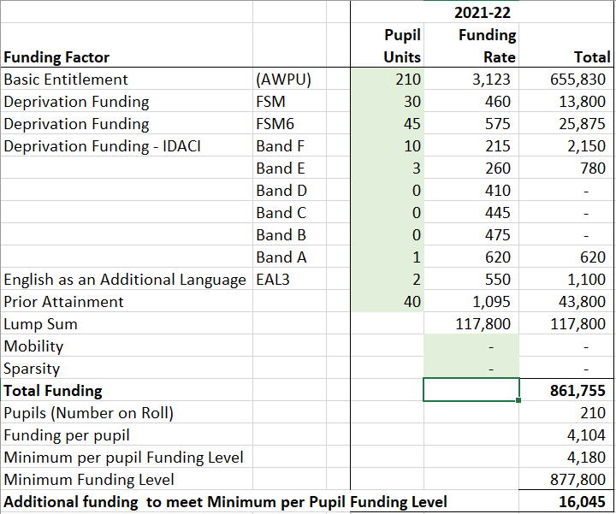
Minimum per Pupil Funding Level

Slide 22
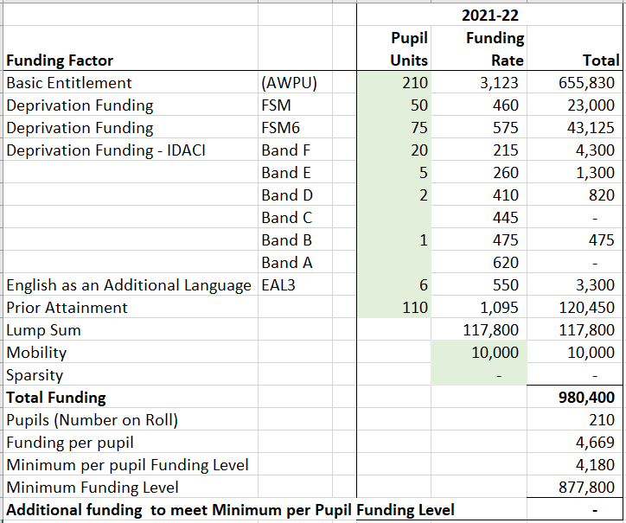
Minimum per Pupil Funding Level

Slide 23
Schools Budget Update 2021-22 - Key Changes
The main funding formula for 2021-22 is similar to 2020-21 but the key following changes should be noted:
Funding schools at National Funding Formula values
An increase in Pupil and School led funding values of 3%
Teachers Pay and Pension Grants being baselined into AWPU values (£180 / £265)
IDACI data has been refreshed
Increases in the minimum per pupil funding levels (MPPFL) to £4,180 and £5,415 in primary and secondary schools
Introduction of Mobility factor
Split Site Allowance up to £90,000

Slide 24
Boost for schools (21-22) – High Needs
Additional £730m nationally
Wiltshire’s share – Extra £5m
Good news – Yes!
Does it provide a sustainable solution?
Wiltshire’s overspend on high needs
- £19m cumulative deficit at end of 2020-21
LA (Schools Forum) will continue to work through high needs issues

Slide 25
High Needs
Allocation of £57m for Wiltshire – what is it for?
Funds Special Schools 6 locations – 812 places
Resource Base places 18 locations – 322 places
ELP places (Enhanced Learning Provision) 27 locations – 317 places
Top-Ups
NPA’s (Named pupil Allowances)
SEN Support at the LA for all schools

Slide 26
What are the funding rates ?
Same in all settings
Resource Bases and (Enhanced Learning Provision) ELP’s - Place funding is determined by the DfE and paid at £6,000 per filled place (not NPA’s)
Top-up rates are agreed locally by Schools Forum and the current rates are detailed in the table below
Pupil registered in a resource base with a band of U1 would attract top-up funding of £4,067, plus the place funding of £6,000 = £10,067.
Pupil with an NPA and band of U1 would attract funding of £4,067 only.

Slide 27
Notional SEN Funding
The Notional SEN funding is an identified amount of money within a school's overall funding that is to contribute to the special educational provision of children with SEN or disabilities.
Funding for notional special educational needs (notional SEN) is not a separate formula factor. In a schools Funding Certificate / GAG Statement local authorities specify how much of the schools funding a school receives through the formula constitutes its notional SEN budget.
From Supporting Information, the breakdown is set out

Slide 28
Notional SEN Funding
DFE Guidance
Schools are expected to use their Notional SEN Budget to:
meet the needs of pupils with high-incidence SEN and
to contribute to the cost of provision for high needs pupils.
DfE guidance states that schools should fund the first £6,000 worth of High Needs Provision for all pupils with SEN. In reality, this figure will vary according to the individual needs of each pupil with SEN and the provision put in place.
On top of the Notional SEN funding, additional ‘top-up’ funding for individual children with an EHCP is available, through a Named Pupil Allowance (NPA). Schools will be familiar with the need for an EHCP and the processes involved.

Slide 29
Quick Breather – Everyone ok?
Budget Planning – February - June

Slide 30
Sources of Income
Funding from LA / DfE
Funding Certificate / GAG
Pupil Premium
Other LA Income
NPA income
High needs top up
Pupil growth funding
Government Grants
UIFSM
PE
Teacher Pay/Pension Grant - Ceasing
Covid – 19
Other Income
Lettings
Bank interest
Donations
Breakfast/after school clubs….
Capital
Formula Capital
Other capital
CIF Bids (Academies)
Balances brought forward

Slide 31
Income
Key Updates
Teachers Pay and Pension Grants ceasing end of 2020-21 year
AWPU Rates uplifted by £180 / £265 to baseline TP&P Grants
Minimum per Pupil Funding Levels increased by £180 / £265
Pupil Premium – now based upon October census not January census
PE Grant – awaiting confirmation about 2021-22
Covid Income – uncertainties
Assumption of 2% income uplift for 2022-23

Slide 32
Expenditure
Payroll Costs
Staffing contract details
Pay awards
Increments
On-costs
Apprenticeship levy
Premises and grounds maintenance
Capital projects
Utilities
Educational supplies
Administration costs
ICT
Insurance costs
Catering
Right Choice for your school
School development plan

Slide 33
Expenditure
Key Updates
Public sector pay freeze for 2021-22
Teachers Pay – increments only
Support Staff – increments
Support Staff - staff earning less than £24,000, £250 uplift so model 1%
Other costs – inflation of 1%
Covid Expenditure - uncertainties

Slide 34
Covid Workforce Fund – staff absenteeism between November to Christmas, claims process due out soon
Covid Catch-Up Premium – Tranche 2 for Spring term paid (£80/£240 per pupil / p.a.)
Recovery Premium – Announcement
£302m for primary and secondary schools
average primary £6,000, average secondary £22,000
£200m for Tutoring
£200m for Summer Schools (face to face) in secondaries
Exceptional Costs (March to July 2020) – now paid, claims window closed
F40 Campaign Group – fighting for additional funding for additional costs and lost income
School Website - Schools in receipt of Catch-Up premium must publish details online

Slide 35
Consultations
For Information
Consultation on Reviewing the Allocation of High Needs Funding for 2022-23 for local authorities.
Closes 24th March 2021
For Action
Consultation on support for small and rural schools – the Sparsity Factor
Using ‘road distances’ not ‘crow flies’
Increasing funding allocation by £10k
Closes 9th April 2021
LA will publish its response on

Slide 36
Schools Financial Value Standard (SFVS)
Self assessment - level of evidence is not prescribed
New format since 2019-20
Submission by 31st March 2021
Checklist - 29 questions over 7 areas in A to G
Dashboard – statistical data for your school
Optional input raw data
RAG rating
https://www.gov.uk/guidance/schools-financial-value-standard-and-assurance-sfvs
Maintained Schools

Slide 37
Schools Resource Management Self-Assessment Tool
Self assessment - level of evidence is not prescribed, but must be signed off by Chair of Trust Board
Introduced for 2019-20
Submission by the 15th April 2021 to the DfE
Checklist - 42 questions over 6 areas
Dashboard – statistical data for your school
Optional input raw data
RAG rating
https://www.gov.uk/government/publications/school-resource-management-self-assessment-tool
Academy Schools

Slide 38
Any Questions?
Grant Davis - grant.davis@wiltshire.gov.uk – 01225 718587

Slide 39
Chairs Forum Evolution
Governor Leadership Forum
Will move back to F2F
We would like to ask you about using remote meeting forums as we move to the new norm

Slide 40
Working Together with WC
Working more closely with WC in support of the governing challenge
Updated constitution and MOU
Maintaining an independent voice
Joint projects
Governor recruitment

Slide 41
What else do you want from the WGA
Type of events
Type of speakers
What are the areas of concern for you

